Slide 1
J’s Gourmet Sandwiches
Created and Designed by: Julia Dunaway

Slide 2

This is our trademark, my logo

Slide 3
ABOUT US
At J’s Gourmet Sandwiches we are more than just a sandwich shop. We are a shop where everyone has a story.
I have faced, conquered, and overcome many obstacles in life. I am who I am today because of the experiences I have had in life and I believe through my story I can help others.
So, our mission is to sell the best food, offer the best service, and offer opportunities for change.
Because everyone's story should be told!

Slide 4
No PROBLEMs
What is my business about?
I am proposing a sandwich shop in the heart of TSTC’s campuses. That makes students feel welcome; a place where they can study, work on projects, hang out with friends and if nothing else have a great meal before they go home for the evening.
Who is this all about?
My customers! My staff! No one knows what someone is going through in life. Many students ae homeless, many are lucky to get one meal a day. Some students might be coming out of the Foster Care system and don’t know where to find answers. Many are struggling for one reason or another. So at J’s Gourmet sandwiches, were not just about the food, were about the people.
What makes J’s Gourmet sandwiches Unique?
Were not just great food. I am offering a place to eat, an opportunity to open up and talk, a place to study and more importantly, making lasting friendships. We come from all aspects of life, and all of our journeys have been different, but we are here, so why not tell our stories.
COSTS AND BUDGET
I have set aside $3500 for the website that will hope go live prior to opening in January of 2022. Start up fee’s for equipment, food, and setting up the store front $150,000. To cover some of this cost, I hope to get backing from local businesses who want to support students receiving a higher education. I believe in the first year we will turn a profit and increase the number of students attending TSTC.
ONLY SOLUTIONS

Slide 5
Navigation Menu
ABOUT US
OUR FOOD
As you know life isn’t fair, and to be honest some of us have been dealt a raw hand. All of our journeys have led us here, that is for a reason.
From hamburgers, to paninis, to our gourmet subs, our famous sides, to our fresh salads, but never forget the fresh baked pies.
DRINKS
EVENTS
An open coffee bar, where you pay what you can….We have juices, sodas and what is more refreshing than a cold glass of water. In the winter we will have hot chocolate and wassail.
Different events for different cultures….from poetry, to music, to comedy and holiday spirit.
BLOGS
GALLERY
Help write your story, I would start with mine. How I persevere in life and that I never given up.
See photos of friendships being built in the ‘place to be’ - J’s Gourmet Sandwiches. The fun, the laughter, building trust and bonds that will last a lifetime.
ASSISTANCE
Where you can volunteer your time, and make donations that would give back to the student body. Making sure they have shelter, food and an education.

Slide 6
PRODUCT OVERVIEW
WE ARE UNIQUE BECAUSE:
We are making a difference in the lives of others.
TELL YOUR STORY:
You never know the one life you might touch.
MY PROMISE:
There will never be a day when someone goes hungry, there would never be a day where someone was not heard. Life isn’t fair and not all of us have been dealt a great hand. But that doesn’t mean we can’t be successful. We are here to help!
WHY SHOULD YOU ACCEPT MY PROPOSAL?
Because positive change will happen for everyone. A lot of our systems are broken, TSTC doesn’t have to be one of them!

Slide 7
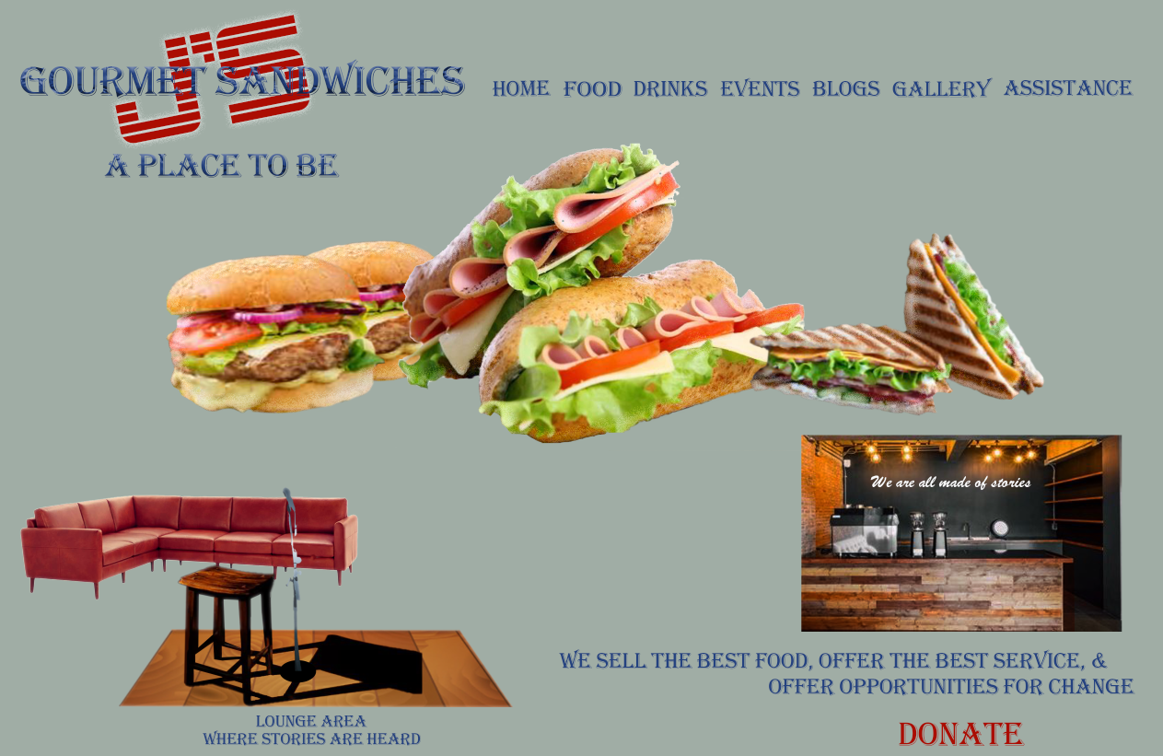

Slide 8
THANK YOU for your time
Julia Dunaway
832-361-2446
jadunaway114660@mymail.tstc.edu

